Slide 1
Summary of the
2022 ERA Registry Annual Report

Slide 2
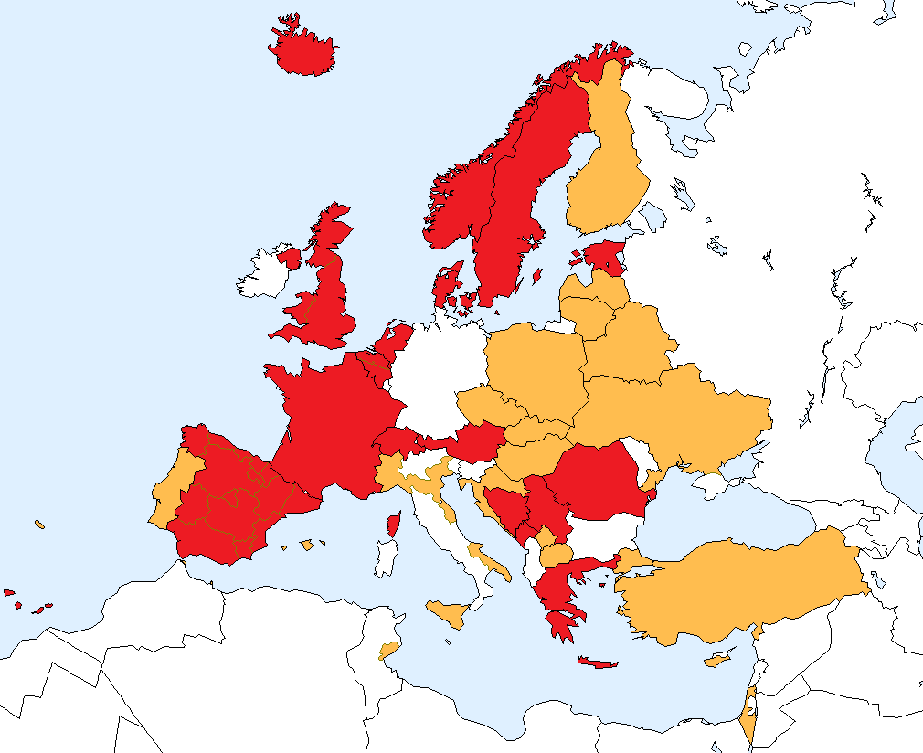
National and regional renal registries that contributed
data to the 2022 ERA Registry Annual Report
Renal registries contributing with individual patient data
Renal registries contributing with aggregated data

Slide 3
Incident patients accepted for KRT in 2022, at day 1
by country
Iceland
Sweden
Norway
Finland
Estonia
United
Kingdom
DK
Latvia
Lithuania
NL
Belarus
Belgium
Poland
Czech
Republic
Ukraine
France
Slovakia
Switzerland
Austria
Portugal
Hungary
Romania
Spain
Croatia
Italy
BA
Serbia
ME
XK
MK
AL
Turkey
Greece
Sfax
Cyprus
Israel

Slide 4
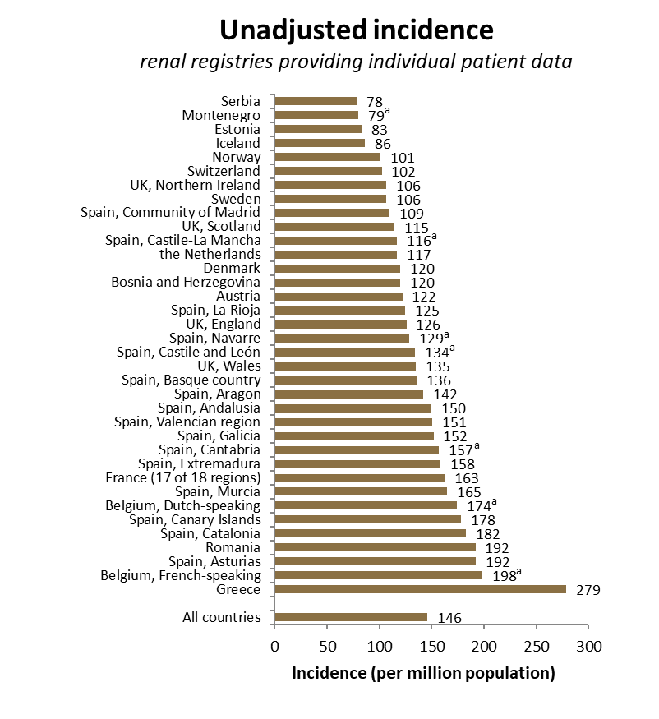
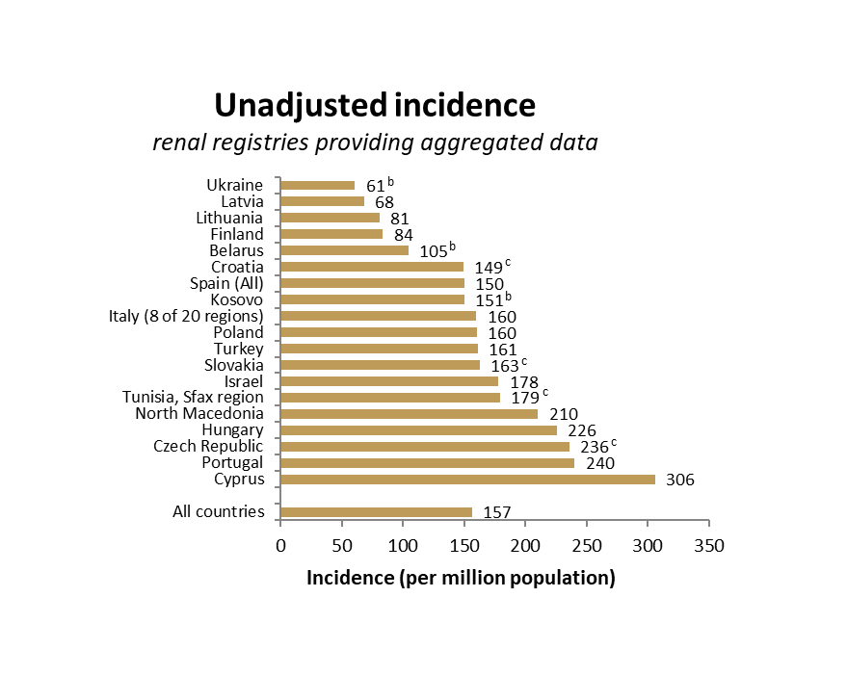
Incident patients accepted for KRT in 2022, at day 1
by country
ª patients younger than 20 years of age are not included; ^{b} patients younger than 18 years of age are not included; ^{c} data includes patients receiving dialysis only

Slide 5
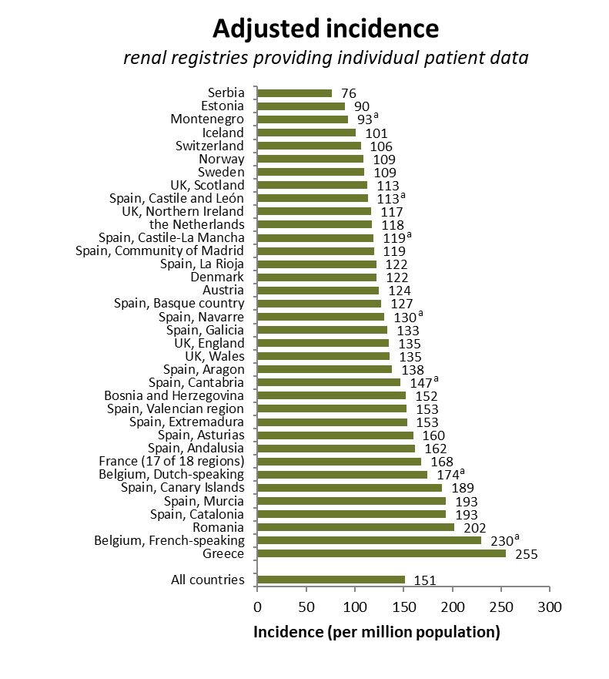
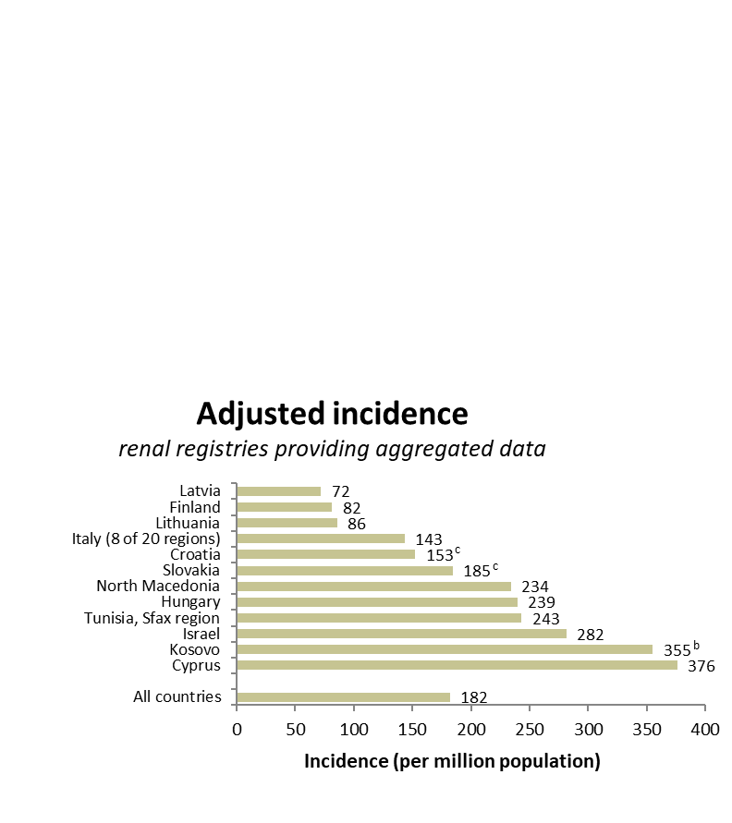
Incident patients accepted for KRT in 2022, at day 1
by country, adjusted for age and sex
ª patients younger than 20 years of age are not included; ^{b} patients younger than 18 years of age are not included; ^{c} data includes patients receiving dialysis only

Slide 6
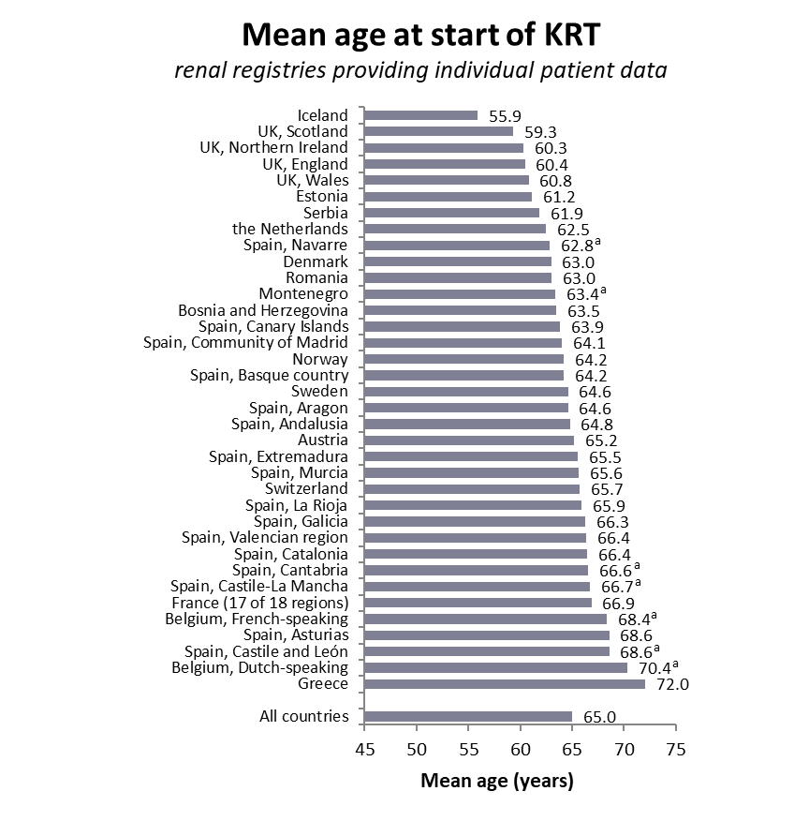
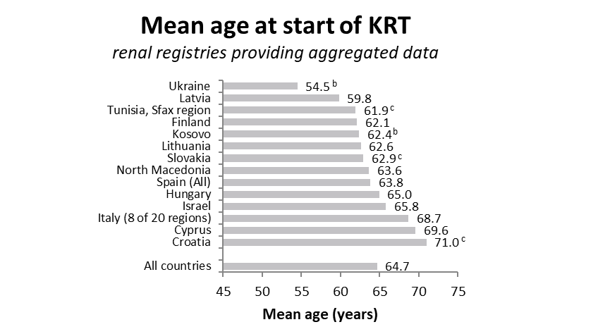
Incident patients accepted for KRT in 2022, at day 1
mean age
ª patients younger than 20 years of age are not included; ^{b} patients younger than 18 years of age are not included; ^{c} data includes patients receiving dialysis only

Slide 7
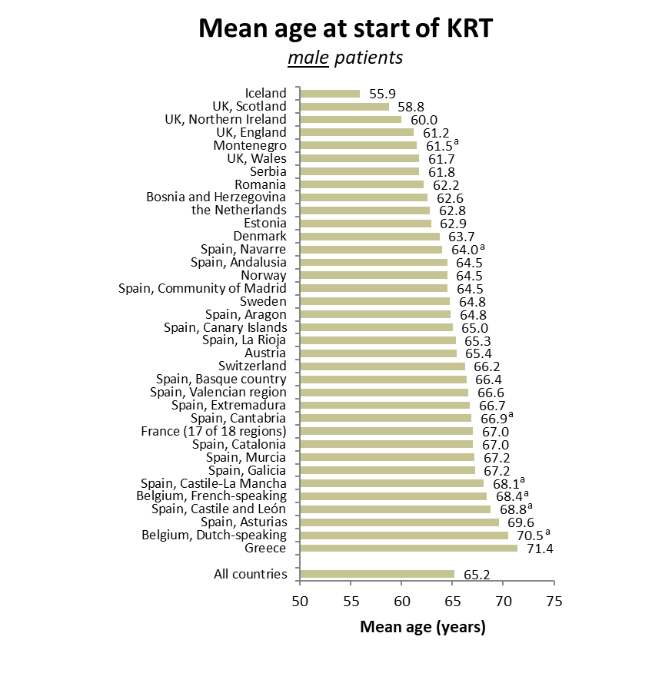
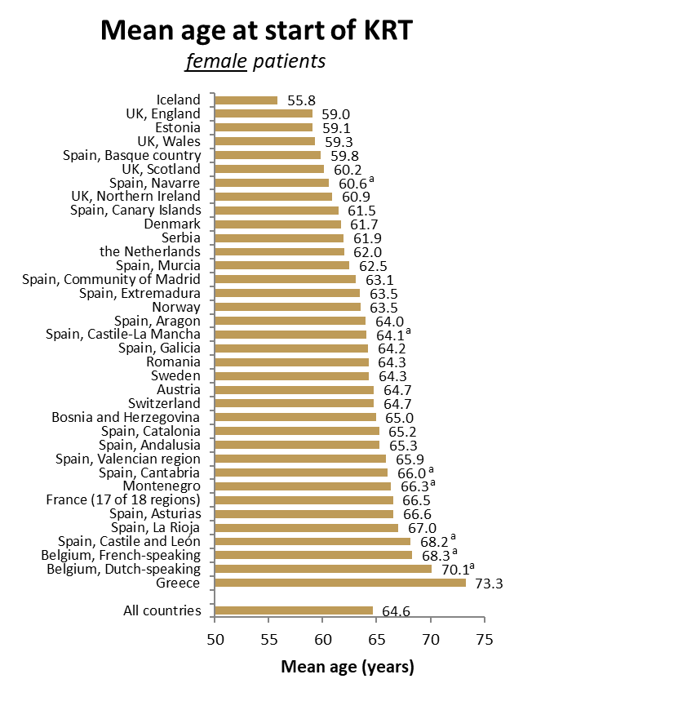
Incident patients accepted for KRT in 2022, at day 1
registries providing individual patient data only
Mean age at start of KRT
male patients
ª patients younger than 20 years of age are not included

Slide 8
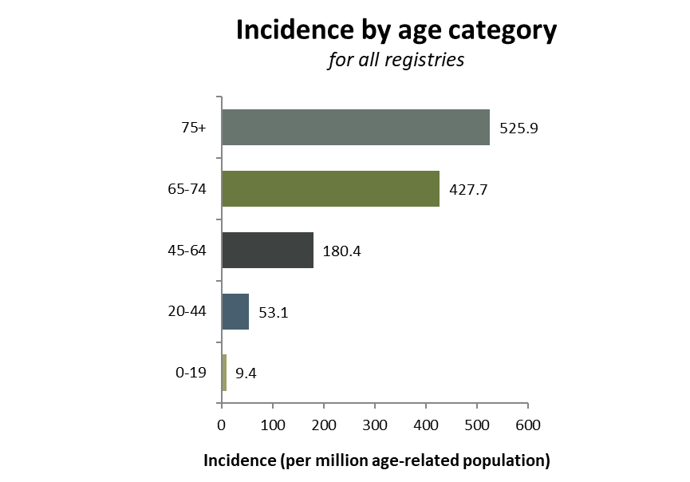
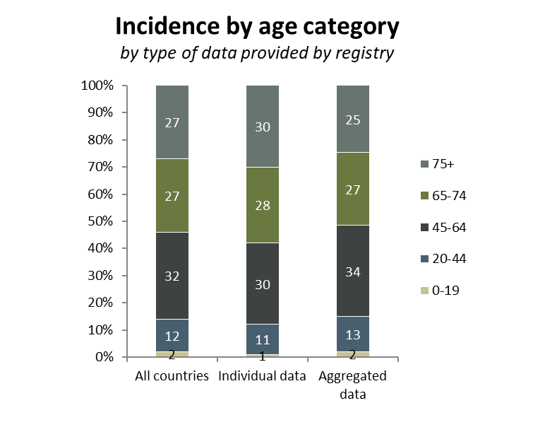
Incident patients accepted for KRT in 2022, at day 1
by age category

Slide 9
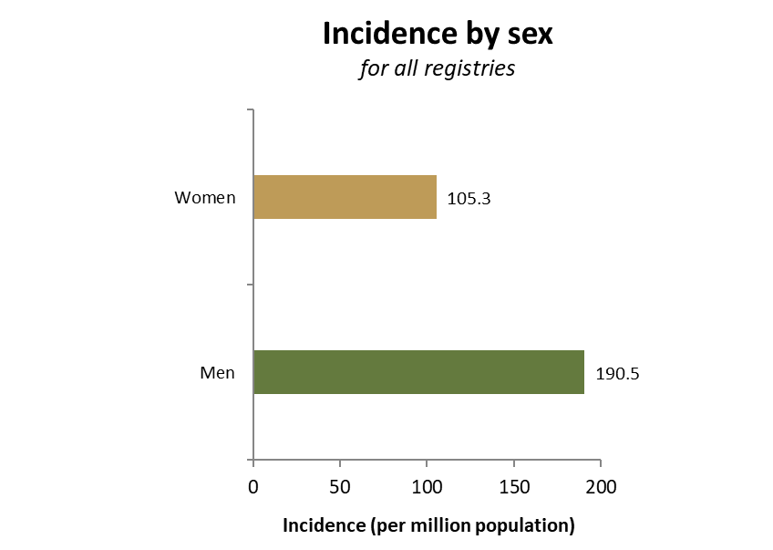
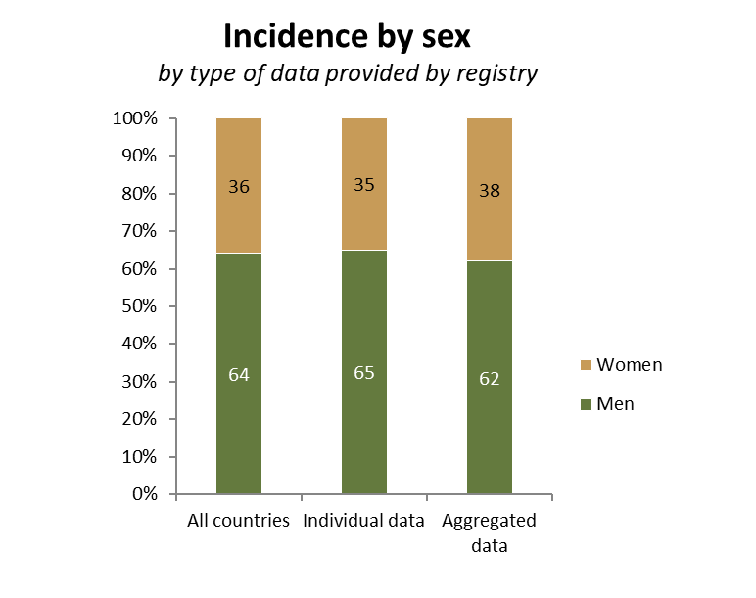
Incident patients accepted for KRT in 2022, at day 1
by sex

Slide 10
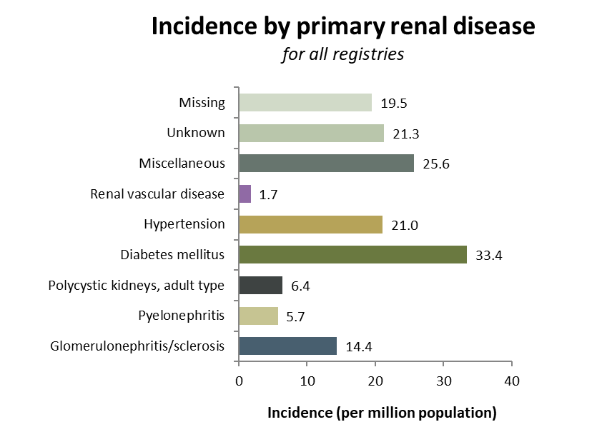
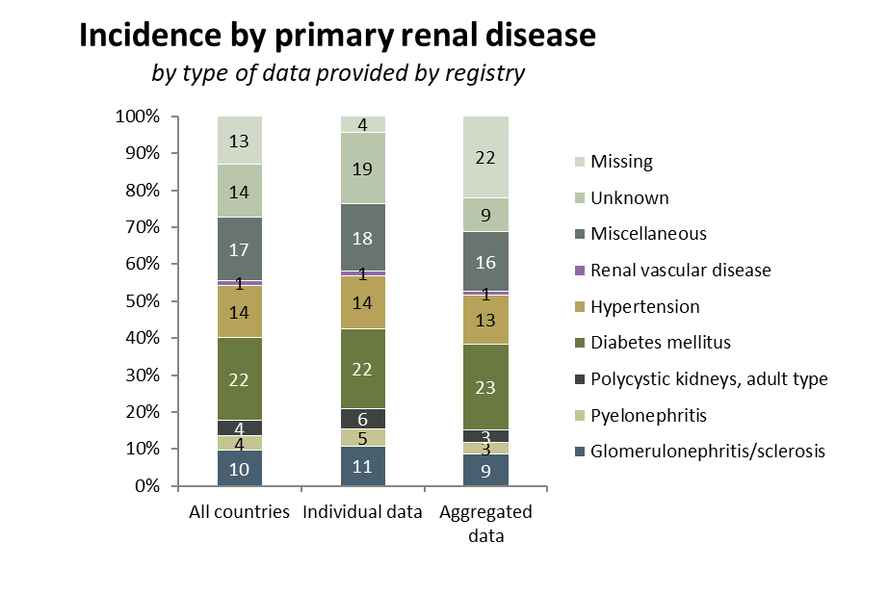
Incident patients accepted for KRT in 2022, at day 1
by primary renal disease (1995 PRD codes)

Slide 11
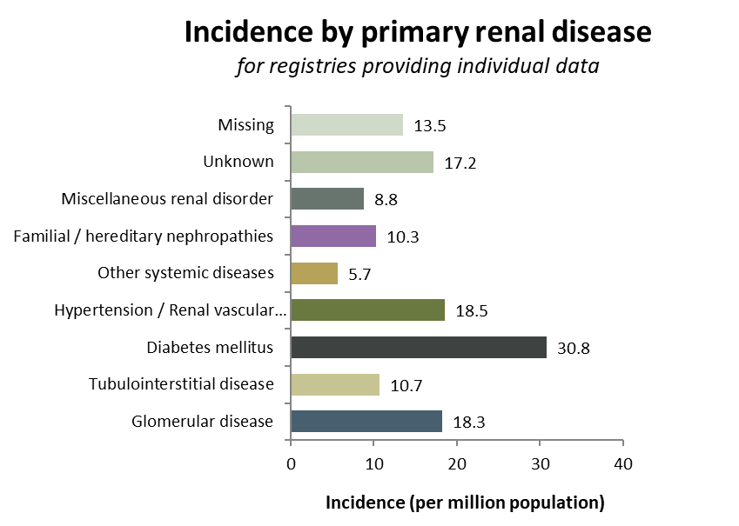
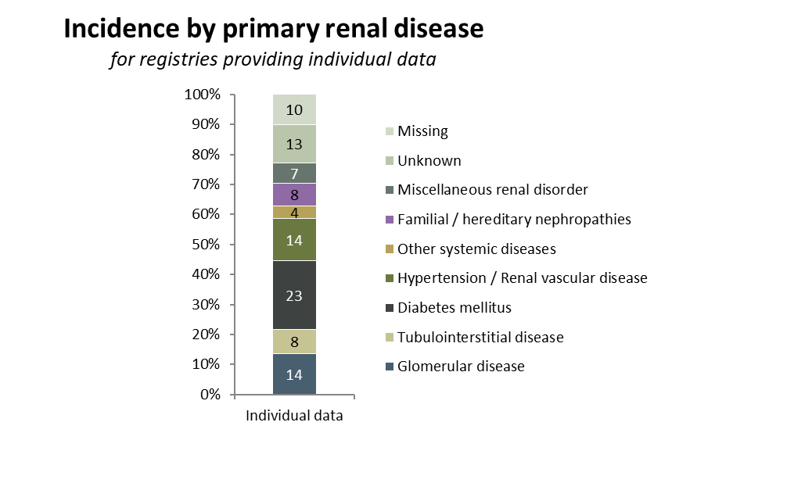
Incident patients accepted for KRT in 2022, at day 1
by primary renal disease (2012/2018 PRD codes)

Slide 12
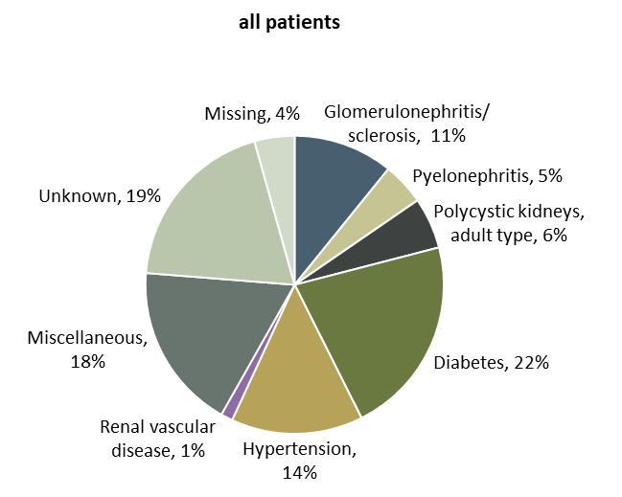
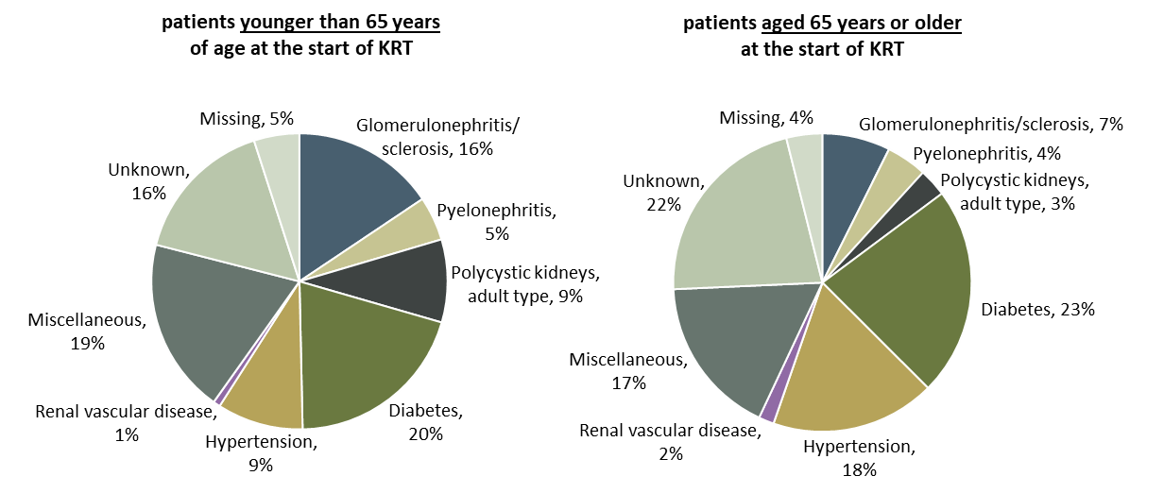
Incident patients accepted for KRT in 2022, at day 1
by primary renal disease (1995 PRD codes) and age category
Incidence by primary renal disease
patients from registries providing individual patient data only

Slide 13
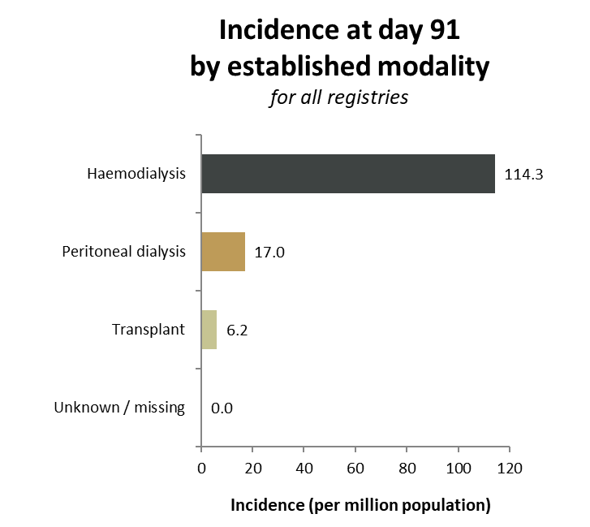
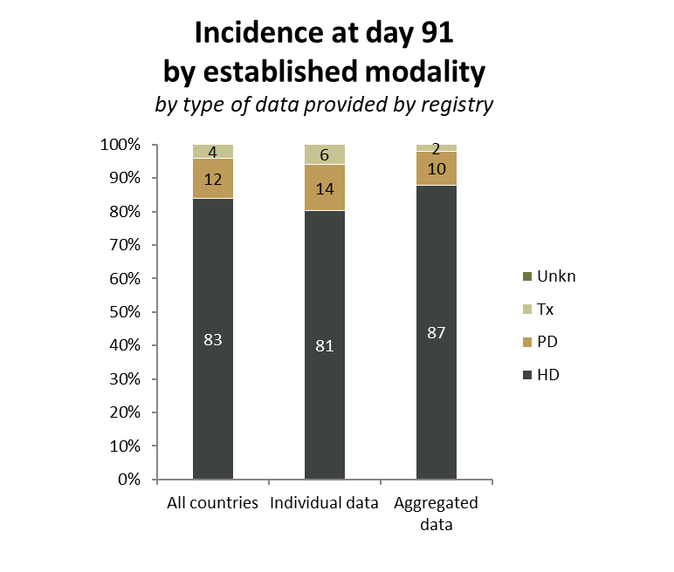
Incident patients accepted for KRT in 2022, at day 91
by established modality

Slide 14
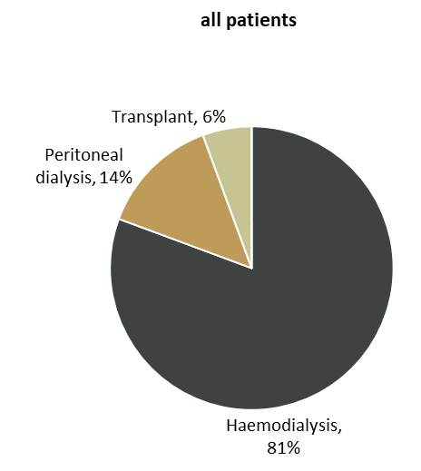
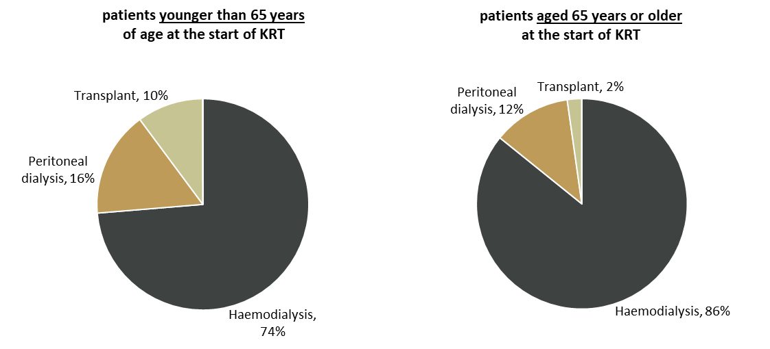
Incident patients accepted for KRT in 2022, at day 91
by established modality and age category
Incidence at day 91 by established modality
patients from registries providing individual patient data only

Slide 15
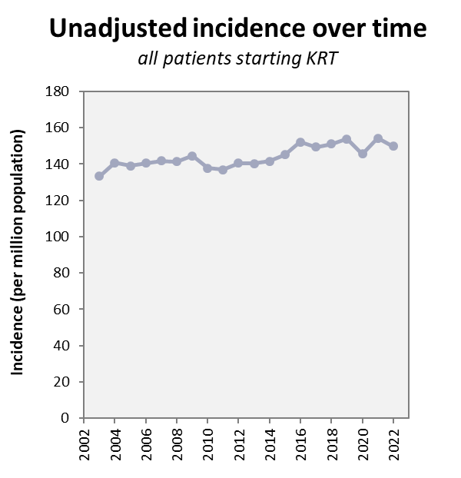
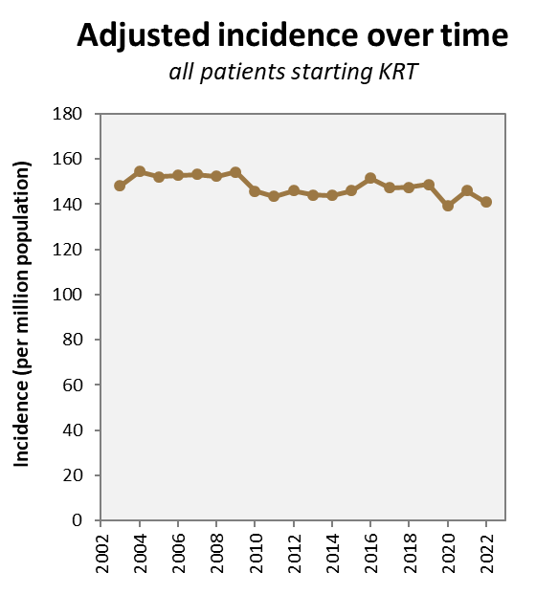
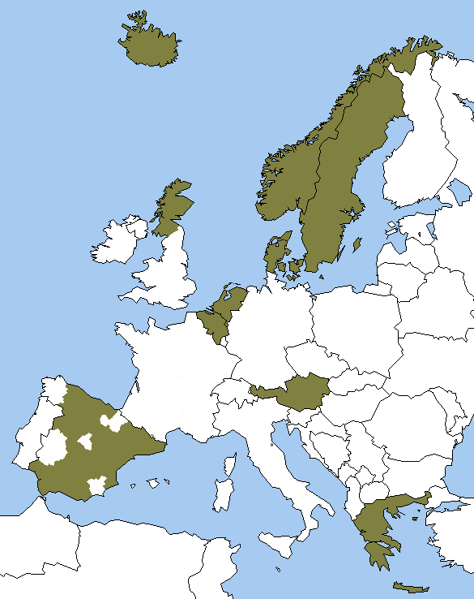
Incident patients accepted for KRT, at day 1
last 20 years (2003-2022)

Slide 16
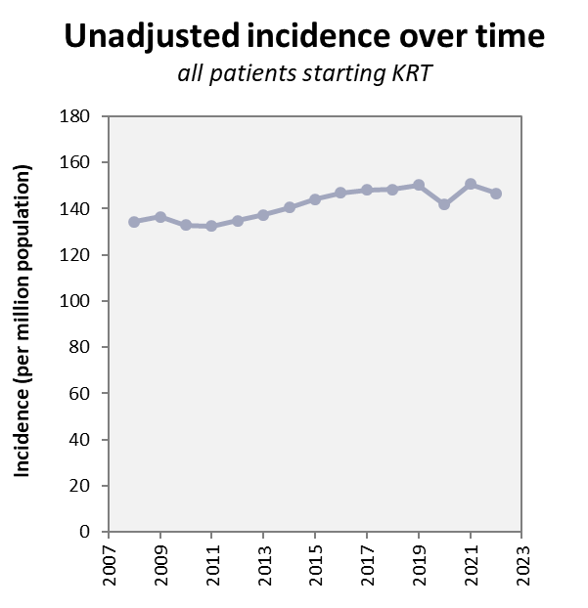
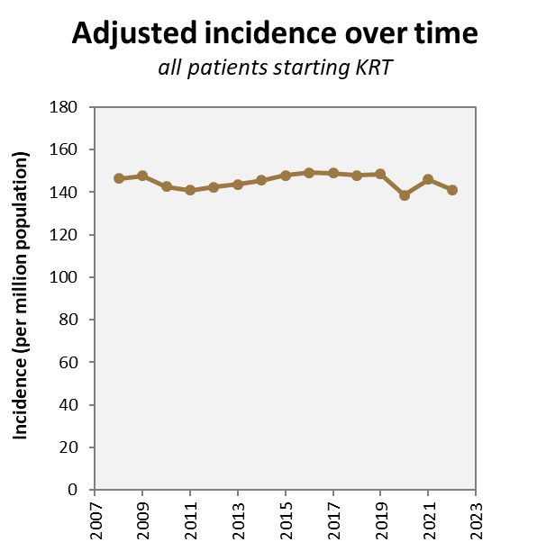
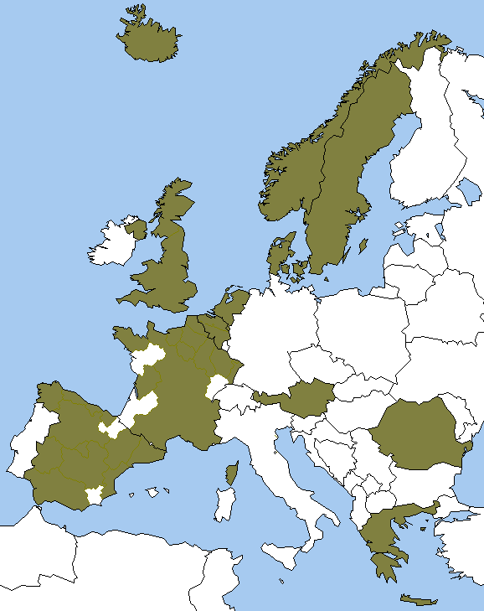
Incident patients accepted for KRT, at day 1
last 15 years (2008-2022)

Slide 17
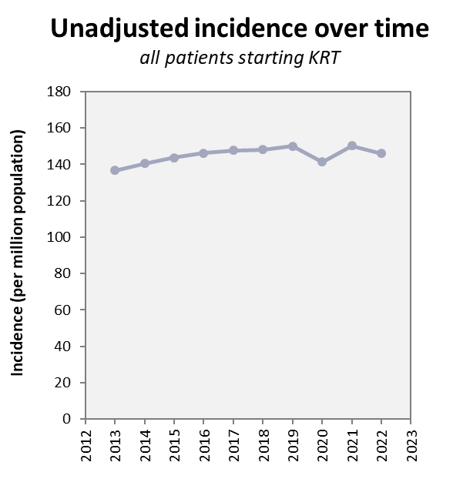
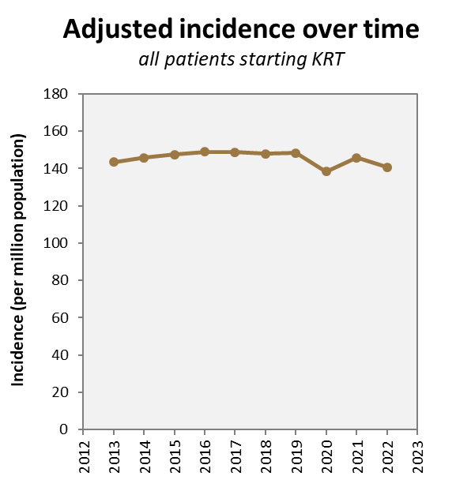
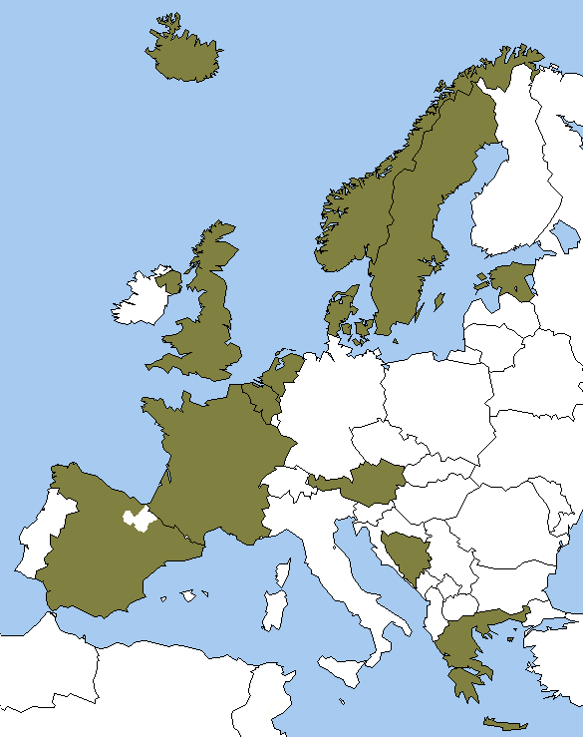
Incident patients accepted for KRT, at day 1
last 10 years (2013-2022)

Slide 18
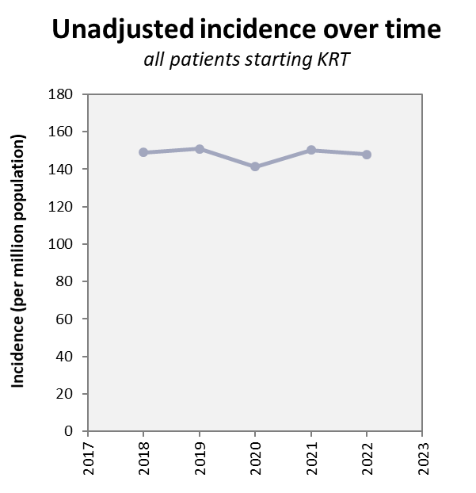
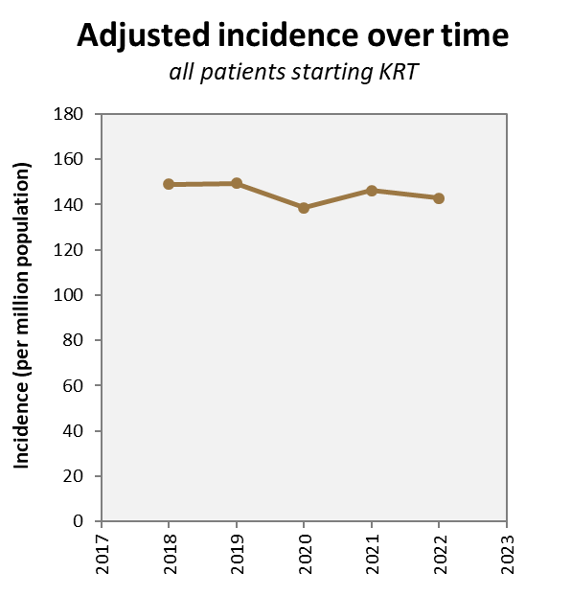
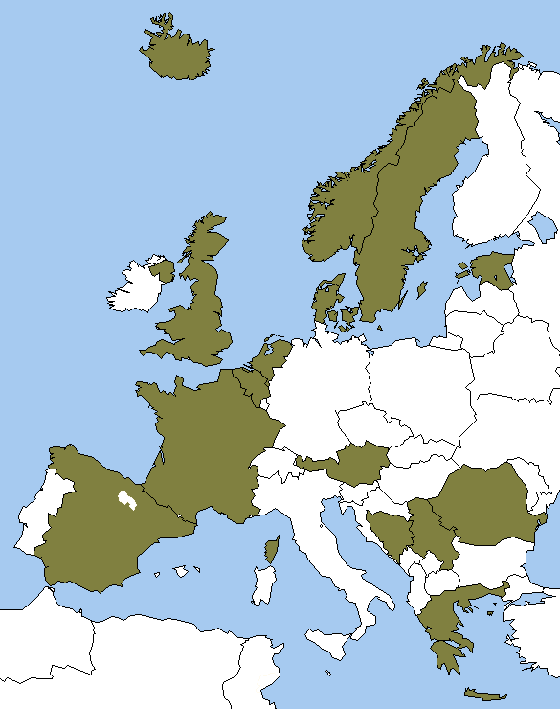
Incident patients accepted for KRT, at day 1
last 5 years (2018-2022)

Slide 19
Prevalent patients on KRT in 2022
by country
Iceland
Sweden
Norway
Finland
Estonia
United
Kingdom
DK
Latvia
Lithuania
NL
Belarus
Belgium
Poland
Czech
Republic
Ukraine
France
Slovakia
Switzerland
Austria
Hungary
Portugal
Croatia
Romania
Spain
Italy
BA
Serbia
ME
XK
MK
AL
Turkey
Greece
Sfax
Israel

Slide 20
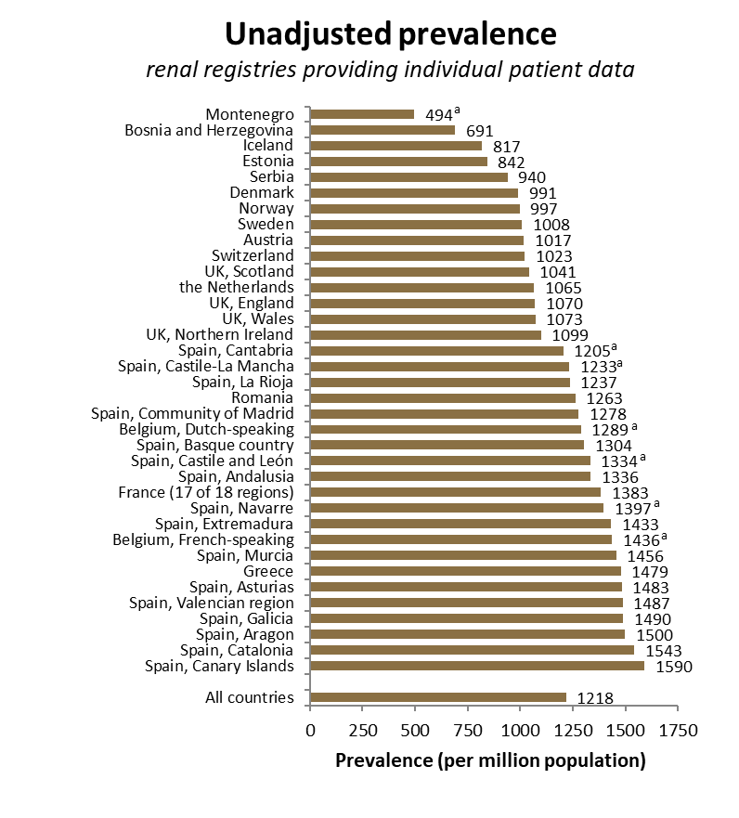
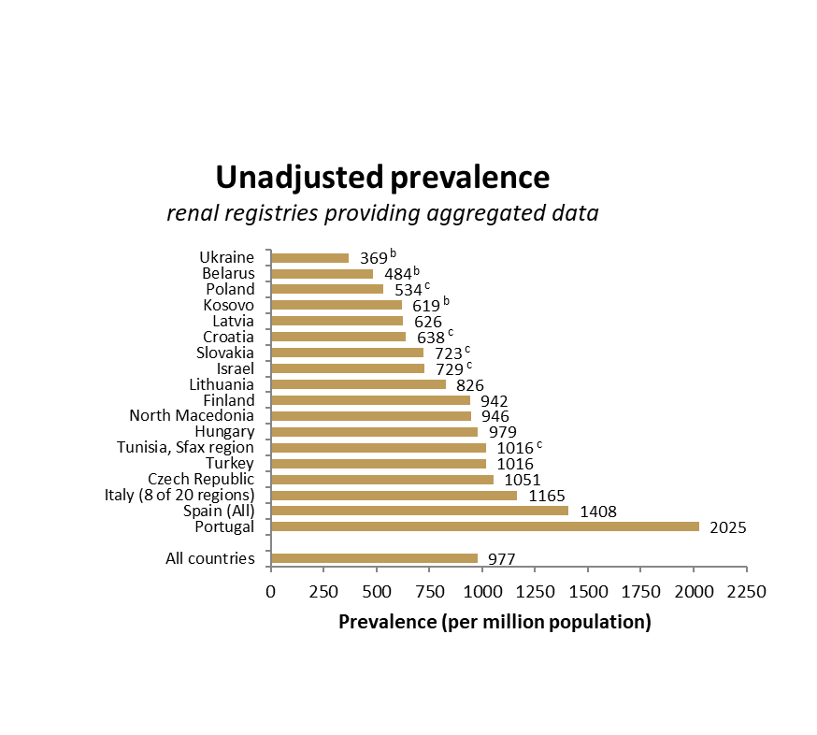
Prevalent patients on KRT in 2022
by country
ª patients younger than 20 years of age are not included; ^{b} patients younger than 18 years of age are not included; ^{c} data includes patients receiving dialysis only

Slide 21
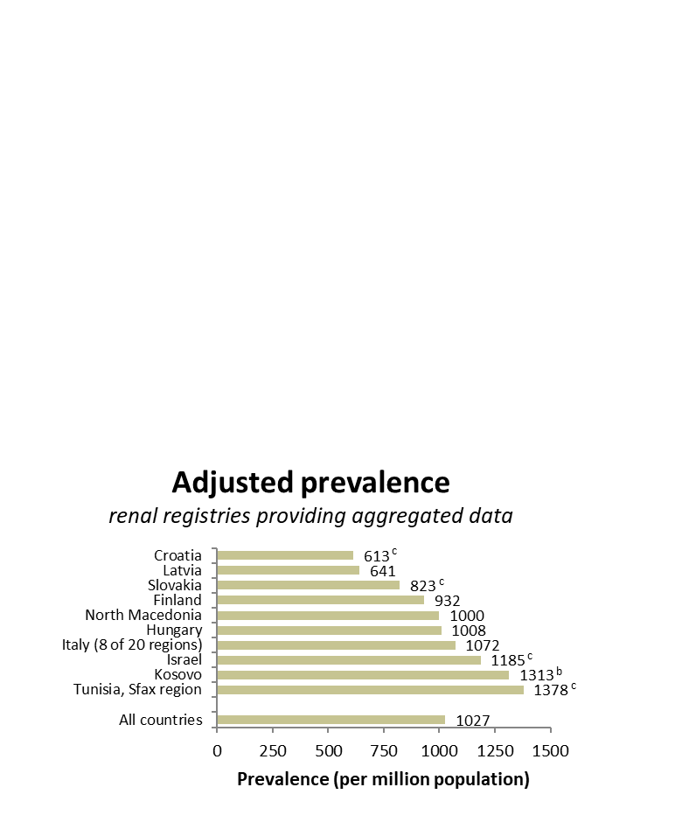
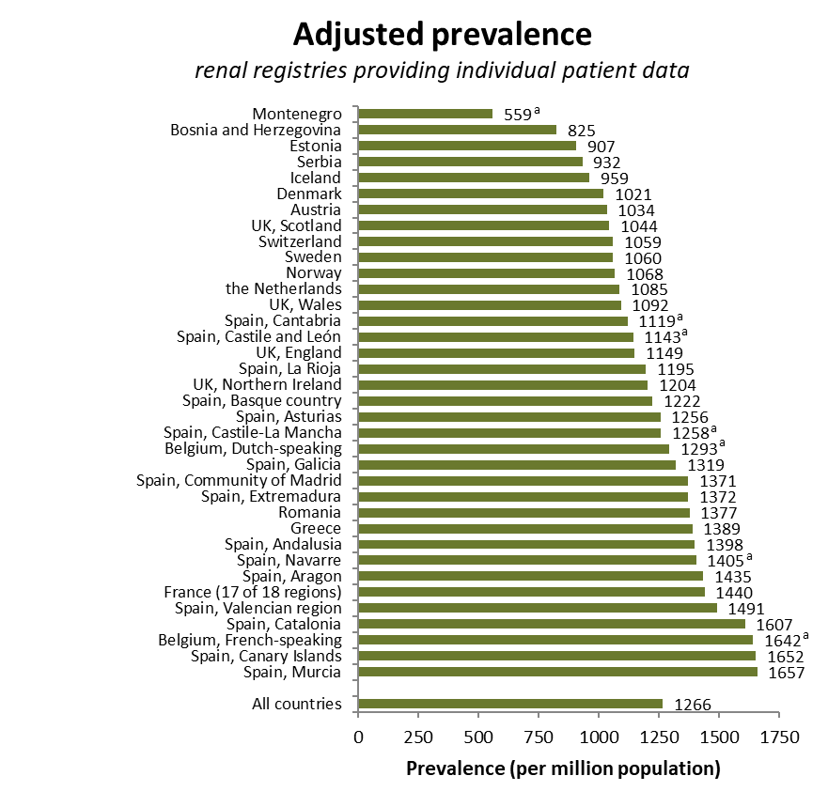
Prevalent patients on KRT in 2022
by country, adjusted for age and sex
ª patients younger than 20 years of age are not included; ^{b} patients younger than 18 years of age are not included; ^{c} data includes patients receiving dialysis only

Slide 22
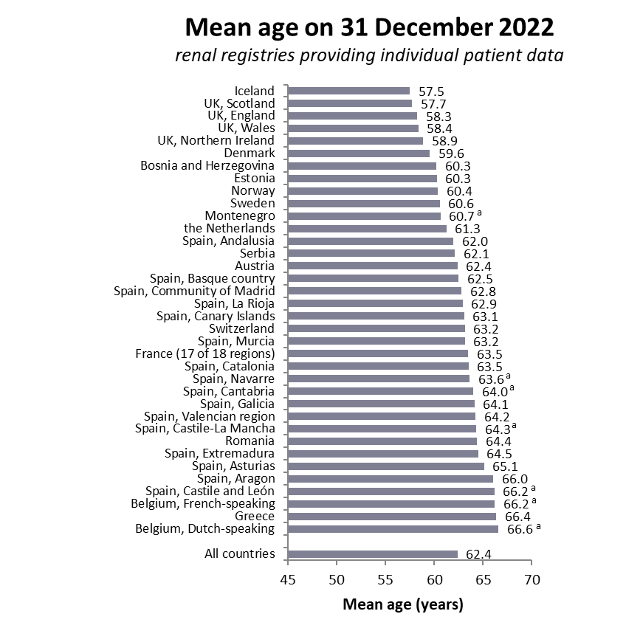
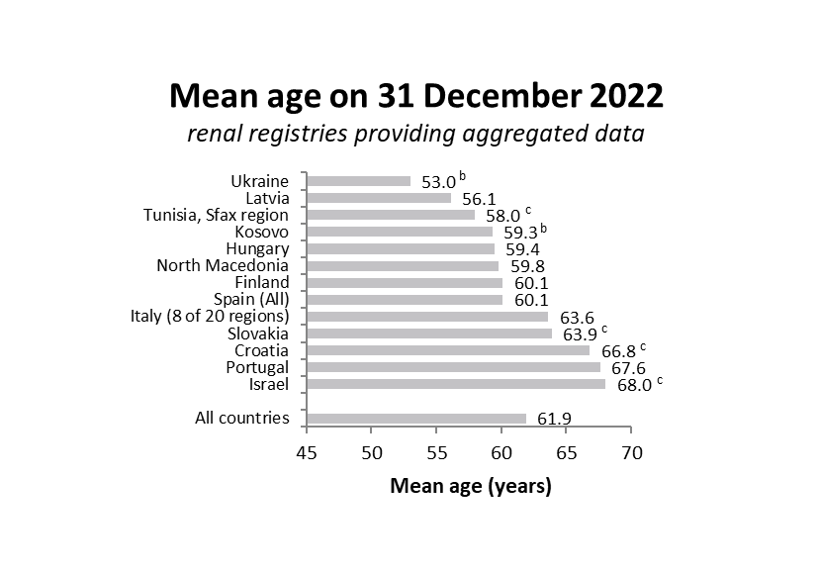
Prevalent patients on KRT in 2022
mean age
ª patients younger than 20 years of age are not included; ^{b} patients younger than 18 years of age are not included; ^{c} data includes patients receiving dialysis only

Slide 23
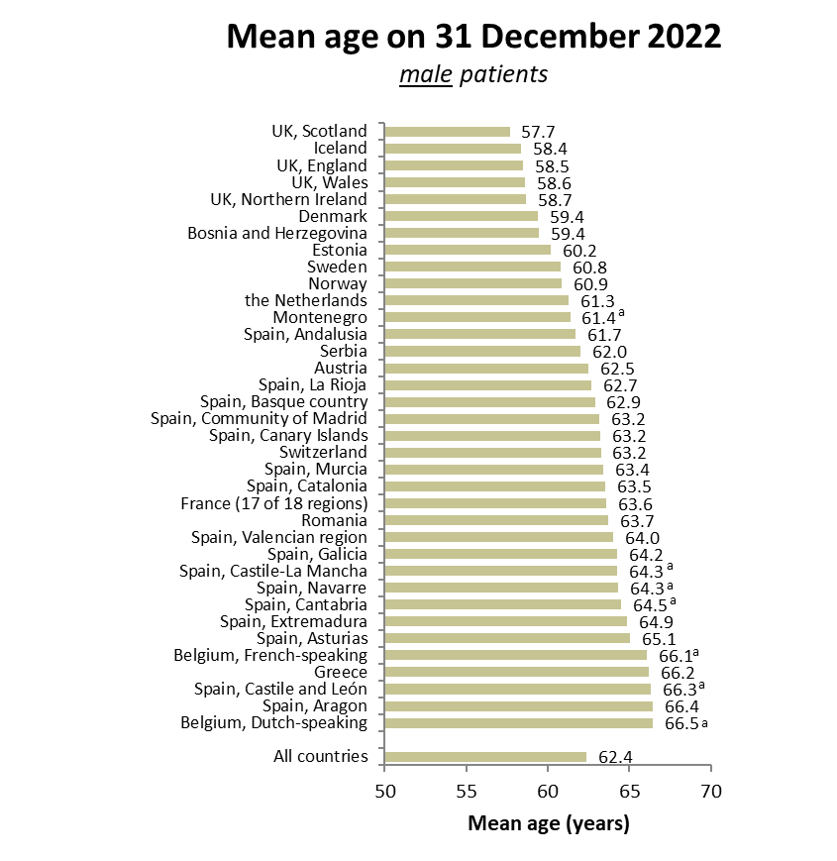
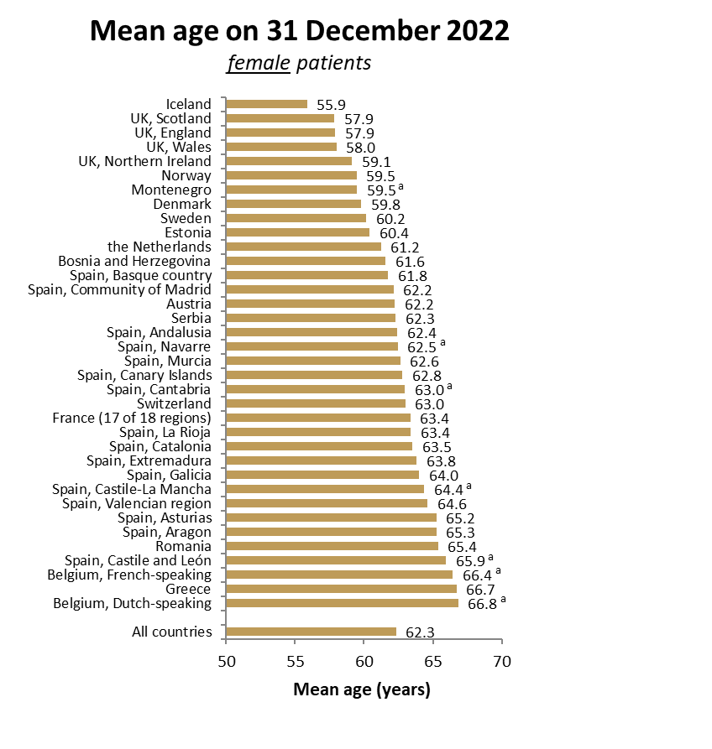
Prevalent patients on KRT in 2022
for registries providing individual patient data only
ª patients younger than 20 years of age are not included;

Slide 24
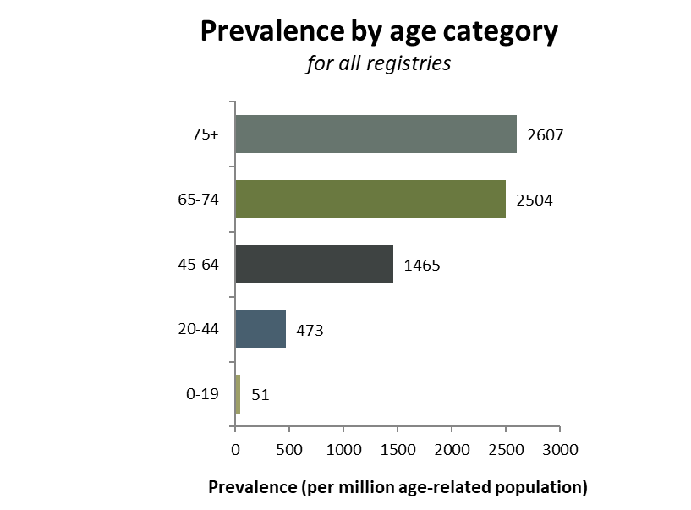
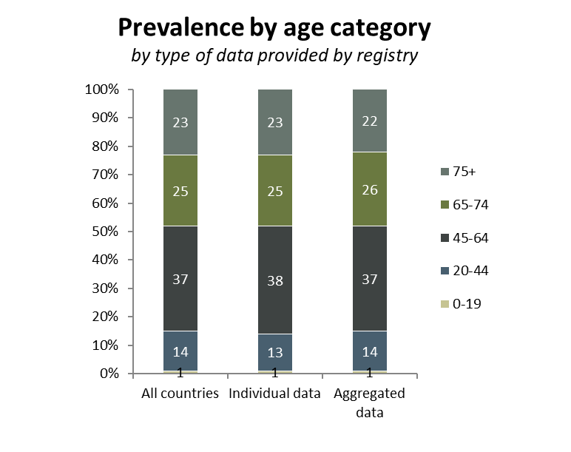
Prevalent patients on KRT in 2022
by age category

Slide 25
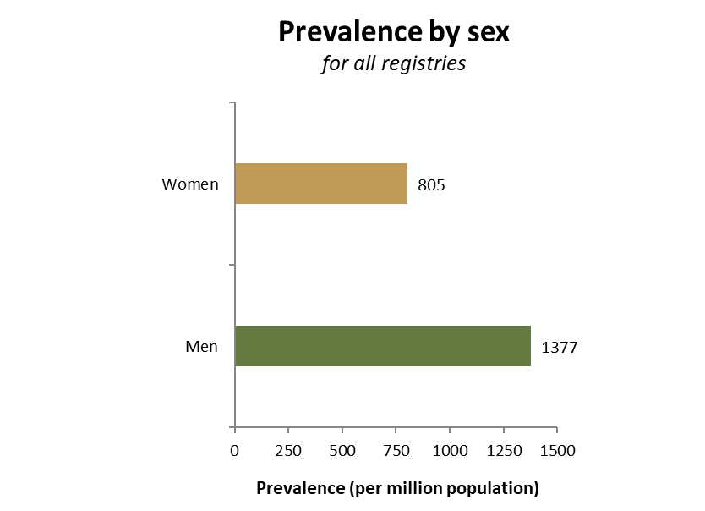
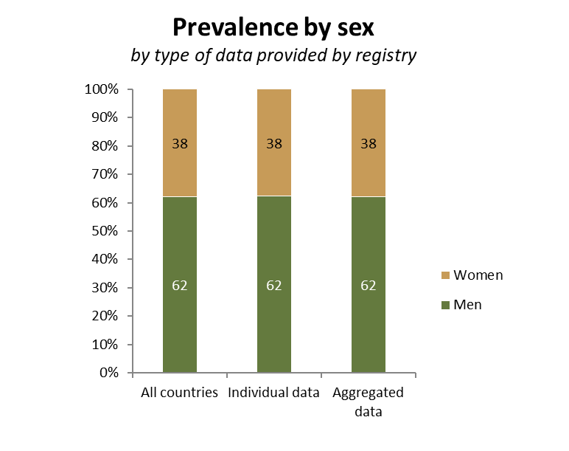
Prevalent patients on KRT in 2022
by sex

Slide 26
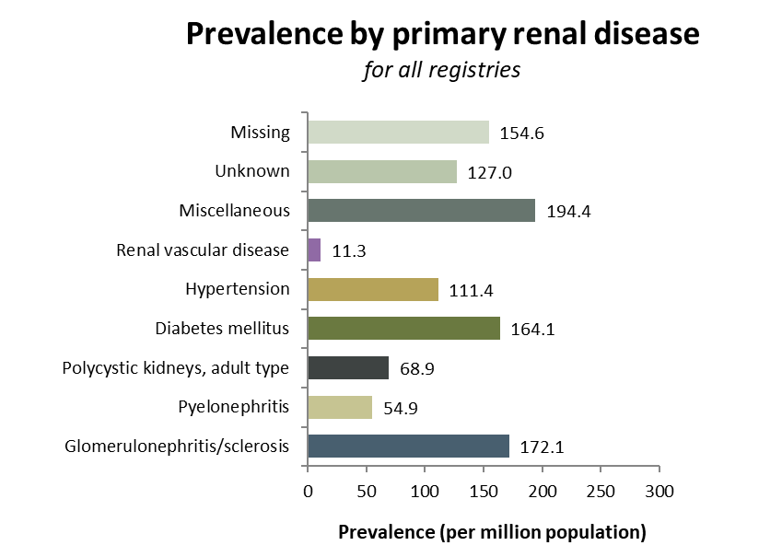
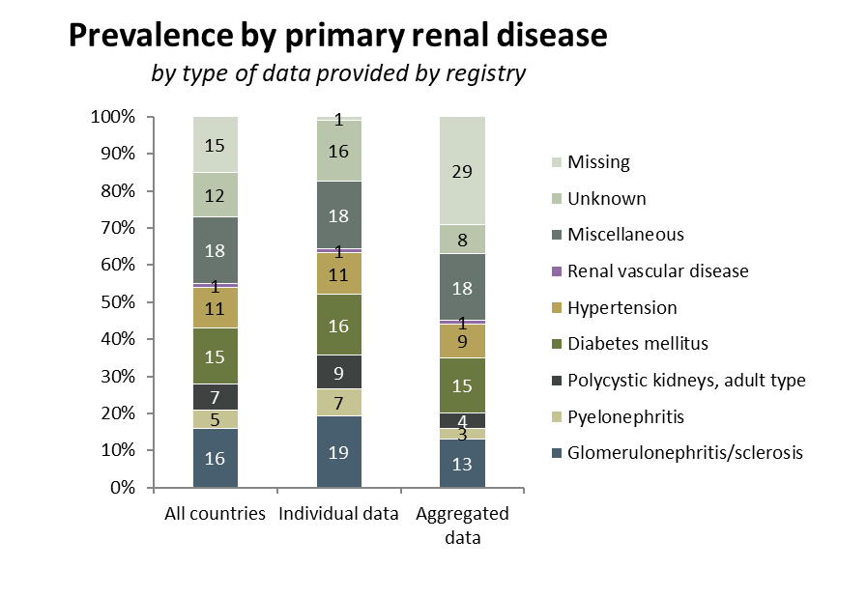
Prevalent patients on KRT in 2022
by primary renal disease (1995 PRD codes)

Slide 27
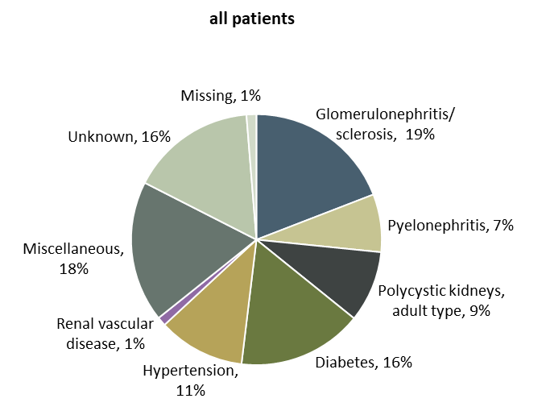

Prevalent patients on KRT in 2022
by primary renal disease (1995 PRD codes) and age category
Prevalence by primary renal disease
patients from registries providing individual patient data only

Slide 28


Prevalent patients on KRT in 2022
by modality

Slide 29


Prevalent patients on KRT in 2022
by modality and age category
Prevalence by modality
patients from registries providing individual patient data only

Slide 30


Prevalent patients on KRT
last 20 years (2003-2022)

Slide 31


Prevalent patients on KRT
last 15 years (2008-2022)

Slide 32


Prevalent patients on KRT
last 10 years (2013-2022)

Slide 33


Prevalent patients on KRT
last 5 years (2018-2022)

Slide 34


Kidney transplantations performed in 2022
by country
ª patients younger than 20 years of age are not included; ^{bc} transplantation rates are underestimated by 15% (b), 30% (c); ^{d} patients younger than 18 years of age are not included

Slide 35


Kidney transplantations performed in 2022
transplants from deceased donors, by country
ª patients younger than 20 years of age are not included; ^{bc} transplantation rates are underestimated by 16% (b), 30% (c); ^{d} patients younger than 18 years of age are not included

Slide 36


Kidney transplantations performed in 2022
transplants from living donors, by country
ª patients younger than 20 years of age are not included; ^{bc} transplant rates are underestimated by 12% (b), 30% (c); ^{d} patients younger than 18 years of age are not included

Slide 37


Kidney transplantations performed in 2022
by donor type

Slide 38


Kidney transplantations performed in 2022
by donor type
Kidney transplantations by donor type
patients from registries providing individual patient data only

Slide 39


Patient survival on KRT
by cohort
Survival probabilities were adjusted for fixed values for age (67 years), sex (63% men), and the primary renal disease distribution (24% diabetes mellitus, 19% hypertension / renal vascular disease, 11% glomerulonephritis and 46% other primary renal diseases).
Cox regression model was used to calculate survival probabilities.

Slide 40

Patient survival on KRT
by cohort
Survival probabilities were adjusted for fixed values for age (67 years), sex (63% men), and the primary renal disease distribution (24% diabetes mellitus, 19% hypertension / renal vascular disease, 11% glomerulonephritis and 46% other primary renal diseases).
Cox regression model was used to calculate survival probabilities.

Slide 41

Patient survival on dialysis
by cohort
Survival probabilities were adjusted for fixed values for age (67 years), sex (63% men), and the primary renal disease distribution (24% diabetes mellitus, 19% hypertension / renal vascular disease, 11% glomerulonephritis and 46% other primary renal diseases).
Cox regression model was used to calculate survival probabilities.

Slide 42

Patient survival on dialysis
by cohort
Survival probabilities were adjusted for fixed values for age (67 years), sex (63% men), and the primary renal disease distribution (24% diabetes mellitus, 19% hypertension / renal vascular disease, 11% glomerulonephritis and 46% other primary renal diseases).
Cox regression model was used to calculate survival probabilities.

Slide 43

Patient survival after kidney transplantation
by cohort
Survival probabilities were adjusted for fixed values for age (50 years), sex (63% men), and the primary renal disease distribution (14% diabetes mellitus, 10% hypertension / renal vascular disease, 23% glomerulonephritis and 53% other primary renal diseases).
Cox regression model was used to calculate survival probabilities.

Slide 44

Patient survival after kidney transplantation
by cohort
Survival probabilities were adjusted for fixed values for age (50 years), sex (63% men), and the primary renal disease distribution (14% diabetes mellitus, 10% hypertension / renal vascular disease, 23% glomerulonephritis and 53% other primary renal diseases).
Cox regression model was used to calculate survival probabilities.

Slide 45

Graft survival after kidney transplantation
by cohort
Survival probabilities were adjusted for fixed values for age (50 years), sex (63% men), and the primary renal disease distribution (14% diabetes mellitus, 10% hypertension / renal vascular disease, 23% glomerulonephritis and 53% other primary renal diseases).
Cox regression model was used to calculate survival probabilities.

Slide 46

Graft survival after kidney transplantation
by cohort
Survival probabilities were adjusted for fixed values for age (50 years), sex (63% men), and the primary renal disease distribution (14% diabetes mellitus, 10% hypertension / renal vascular disease, 23% glomerulonephritis and 53% other primary renal diseases).
Cox regression model was used to calculate survival probabilities.

Slide 47

Expected remaining lifetime
prevalent patients (2018-2022)
Age (years)

Slide 48

Expected remaining lifetime
prevalent patients (2018-2022)

